Slide 1

Algorithm Comparison Based on Input Size Scaling Comparing Time Complexities: O(n²) vs O(n³)
CSA0667-Design And Analysis Of Algorithm
Presented By:
S. Prateeksha (192572137)
Guide By:
Dr.M.Manikandan

Slide 2
Introduction
Algorithms are step-by-step procedures used to solve computational problems efficiently.
Time complexity measures how the execution time or number of operations increases as the input size grows. This comparison focuses on two algorithms with O(n²) and O(n³) time complexities.
Increasing input sizes are used to analyze and compare the performance of both algorithms through tables and graphs.
The goal is to identify which algorithm scales better and is more suitable for handling larger datasets efficiently.

Slide 3
Objective
Compare the performance of two algorithms:
Algorithm A – O(n²)
Algorithm B – O(n³)
Analyze how execution steps increase with larger input sizes. Visualize the growth using tables and graphs.
Identify the more efficient algorithm.

Slide 4
Dataset Assumptions
Input size (n) ranges from 10 to 100 Both algorithms process the same dataset.
Hardware and software environment remain constant.
Only theoretical time complexity is considered.
Number of operations is estimated using:
Algorithm A: n²
Algorithm B: n³

Slide 5
Performance Comparison Table
Input Size (n) | O(n²) | O(n³)
10 | 100 | 1000
20 | 400 | 8000
30 | 900 | 27000
40 | 16002 | 64000

Slide 6
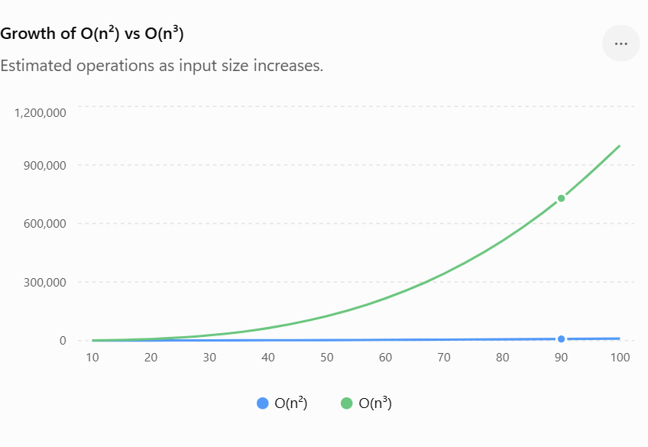
Graphical Visualization

Slide 7
Analysis
Both algorithms require more operations as n increases. O(n²) grows moderately.
O(n³) grows much faster.
At n = 100: O(n²) = 10,000 operations
O(n³) = 1,000,000 operations
O(n³) performs about 100× more operations than O(n²) at this input siz

Slide 8
Justification
O(n²) requires fewer operations than O(n³) for the same input size, making it more efficient.
As the input size increases, O(n³) grows much faster, leading to higher execution time.
The comparison table and graph clearly show that O(n²) scales better for larger datasets.
Therefore, O(n²) is the preferred algorithm because it provides better performance, scalability, and computational efficiency.

Slide 9
Result
The O(n²) algorithm showed a slower growth in operations compared to the O(n³) algorithm as the input size increased.
The O(n³) algorithm required significantly more computations, especially for larger datasets.
The comparison table and graph clearly demonstrated that O(n³) grows much faster than O(n²).
The O(n²) algorithm performed more efficiently and scaled better with increasing input sizes.
Overall, the analysis concluded that O(n²) is the better choice for larger datasets due to its lower computational complexity and improved performance

Slide 10
Conclusion
Time complexity greatly affects algorithm performance.
As input size increases, O(n³) becomes much less efficient.
O(n²) scales better and requires far fewer operations.
Therefore, O(n²) is the preferred algorithm for larger datasets due to its lower computational complexity.

Slide 11
THANK YOU

